Slide 1
Unit - 02
Local and Global variable

Slide 2
Scope of Variables
Variables may be visible throughout a file, module, or a block of code.
Local Variables
The variables declared inside a function are local to that function. It can be accessed only with in that function
Each local variable in a function comes into existence only when the
function is called.
Local variables disappear when the function is exited.
Such variables are usually known as automatic variables.
If other modules need to use them, then they must be coupled through parameters and return values.

Slide 3
Global Variables
The variables declared outside of all function are global variables. These global variables are visible to all functions.

Slide 4
Control
Module2
Module1
Module3
Scope of Local and Global Variables

Slide 5
Local to module1
Variables A,B,C
Global to all Modules
Control
Variables X,Y,Z
Local to control
Module1
Variables D,E,F
Local to module1
Module2
Variables G,H,I
Local to module2
Module3
Variables X,J,K
Local to module3

Slide 6
Local Variables Example
Usage of Local Variables
#include <stdio.h>
void func1(void)
{
int i=10;
printf( "func1(): i=%d \n",i);
}
int main( void )
{
int i=5;
printf( "main(): i=%d\n",i);
func1();
printf( "main(): i=%d\n",i);
return 0 ;
}

Slide 7
Global Variables Example
Usage of Global Variables
#include <stdio.h>
int x=5;
void func1(void)
{
x=x*x;
}
int main( void )
{
printf( "Before: x=%d\n",x);
func1();
printf( "After: x=%d\n",x);
return 0 ;
}

Slide 8
USE PARAMETERS IN THREE WAYS
FORMAL PARAMETERS VERSUS ACTUAL PARAMETERS
CALLING MODULE VERSUS CALLED MODULE
CALL BY VALUE VERSUS CALL BY REFERENCE

Slide 9
Parameter Terminology
  Control Pay
  Process Read(*Hours,*PayRate)
  Process Calc (Hours, PayRate,*Pay)
  Process Print (Pay)
  End
  Read(*Hrs,*Rate)
  Enter Hrs, Rate
  Print Hrs, Rate
  Exit
  Calc (Hrs, Rate,*Pay)
  Pay=Hrs*Rate
  Exit
  Print (Pay)
  Print Pay
  Exit
CALLING MODULE
Actual parameters Listings
Formal Parameters Listings
CALLED MODULE
* indicates Call by reference
Without * Call by value

Slide 10
Passing arguments to a function
Passing arguments to a Function
The mechanism used to pass data to a function is via argument list. There are two approaches to passing arguments to a function. These are
      Call by Value
      Call by Reference

Slide 11
Call by Value
Whenever variables are passed as arguments to a function, their values are copied to the corresponding function parameters
The called function can only return one value
The called function cannot modify the original argument passed to it

Slide 12
Call by Value
Call by Value
Example Program that illustrates Call by Value mechanism
void main()
{
int a, b;
a=10;
b=20;
swap(a, b); /* passing the values of a and b to c and d
of swap function*/
printf(“%d %d”, a, b);
}
void swap(int c, int d) /* Function used to swap the values of
variables c and d */
{
int temp;
temp = c;
c = d;
d = temp;
}
/* Prints 10 20 */

Slide 13
Call by Reference
1 Passing an address as an argument when the
function is called
2. Declare function parameters to be pointers
3. The called function will directly modify the original
argument passed to it. No needs to return anything.

Slide 14
Call by Reference
Example : Program that illustrates Call by Reference mechanism
void main()
{
int a, b;
a=10;
b=20;
swap(&a, &b); /* passing the addresses of a and b to c and
d of swap function*/
printf(“%d %d”, a, b);
}
void swap(int *c, int *d)
{
int temp;
temp = *c;
*c = *d;
*d = temp;
}
/* Prints 20 10 */

Slide 15
RETURN VALUES
When Functions are used within another instruction, they have a return value.
The return value is the result of the function.

Slide 16
Module And It’s Function

Slide 17
Module
In software, a module is a part of a program that performs a distinct function.
Programs are composed of one or more independently developed routines (Module) that are not combined until the program is linked.
A single module can contain one or several routines.

Slide 18
Modules and It’s Functions
Breaks the problem into modules, each with a specific function.
Rules for Designing a modules
1.An entity with one entry and one exit
2.performs a single function
3.Easy to read and modify
4.Length of module Depends on the Operation
5.Is developed to control the order of processing
Types of Modules:
1.Control Module
2.Initialization Module
3.Process Module
1.calculation module
2.Print Module
3.Read and data validation module
4.Wrapup Modules

Slide 19
Cohesion and Coupling
Cohesion:
Module to work independently from all other modules.
Coupling:
Some type of interface between modules that enables data to be passed from one module to another.

Slide 20
Cohesion & Coupling

Slide 21
Cohesion is the ability for each module to work independently from all other modules
Module 1
Module 2
Coupling allows modules to share data
Module 3
Module 4

Slide 22
Coupling and Data Dictionary
Coupling:
It shows which variables are passed from one module to another.
Data Dictionary:
It help to keep track of the variable usage in your program .It contains a list of all items ,their variable names, their data types, the module in which they are found and error check that needs to be made on the variable.

Slide 23
Coupling Diagram
Control pay
Pay
hours
hours
Pay rate
Pay
Pay rate
Pay
Pay
hrs
Rate
hrs
Rate
Read
Calc
Print

Slide 24
Data Dictionary

Slide 25
DATA DICTIONARY
ITEM | VARIABLE NAME | DATA TYPE | MODULE | SCOPE | PSEUDONYM/MODULE | ERROR CHECK
Hours worked | Hours | Numeric-real | Control pay | Local | Hrs | None
Hours worked | Hrs | Numeric-real | Read/calc | Parameter | Hours | Hours<0
Pay Rate | Pay rate | Numeric-real | Control pay | Local | Rate | None
Pay Rate | Rate | Numeric-real | Read/calc | Parameter | Payrate | Pay rate<4.00
Net Pay | Pay | Numeric-real | Control pay | Local | None | None
Net Pay | Pay | Numeric-real | Calc/print | Parameter | None | None

Slide 26
STRUCTURING A PROGRAM
Four logic structures:
1.Sequential structure
2.Decision structure
3.Loop structure
4.Case structure

Slide 27


SELECTION
The traffic light is an example of ‘the programming concept’ we refer to as SELECTION
Notes:
thiss is for selection

Slide 28



SEQUENCE
Getting up → getting dressed → having breakfast → catching a bus → starting work
This an example of a ‘programming concept’ we refer to as SEQUENCE

Slide 29


ITERATION
Maybe you go shopping a few times a week
Monday Tuesday Wednesday
Wake up Wake up Wake up
Get into car Get into car Get into car
Do shopping Do shopping Do shopping
Come home Come home Come home

Slide 30
Sequential logic structure
Executes instructions one after another in a sequence
Instruction
Instruction
Instruction

Slide 31
Decision logic structure
To execute one of two possible sets of instructions
Decision
Instruction
Instruction
Instruction

Slide 32
Loop logic structure
Executes a set of instructions many times
Loop Instruction
Instruction
Instruction
Instruction

Slide 33
Case logic structure
Executes one set of instructions out of several sets
Case of
variable
=CONSTANT 1
=CONSTANT 2
=CONSTANT 3
=CONSTANT 4
OTHERWISE
Instruction
Instruction
Instruction
Instruction
Instruction

Slide 34
Problem solving with sequential logic structure

Slide 35
Problem solving with the Sequential Logic Structure
Algorithm:
is a systematic procedure that produces - in a finite number of steps - the answer to a question or the solution of a problem.
is a sequence of instructions which can be used to solve a given problem
Flowchart:
A graphical representation of a process in which graphic objects are used to indicate the steps & decisions that are taken as the process moves along from start to finish.

Slide 36
Flowchart Symbols
Start or stop
Process
Input or output
Decision
Flow line
Connector

Slide 37
Six steps for Developing a Solution
1.The problem Analysis chart ( PAC )
2.Interactivity chart
3.IPO chart
4.Coupling Diagram and Data Dictionary
5.Algorithm
6.Flowchart

Slide 38
Problem: Mary Smith is looking for the bank that will give the most return on her money over the next five years. She has $2000 to put into a savings account. The standard equation to calculate principal plus interest at the end of a period of time is
Amount=P*(1+I/M)^(N*M)
Where
P=Principal (amount of money to invest, in this case
$2000)
I=Interest (Percentage rate the bank pays to the
investor)
N=Number of years (time for which the principal is
invested)
M=Compound Interval (the number of times per year the
interest is calculated and added to the principal)

Slide 39
Problem Analysis Chart
Given Data | Required Results
Principal-$2000 Interest Number of years-5 Compound Interest(#/year) | Principal plus Interest at the end of the time period
Processing required | Solution alternatives
Amount=P*(1+I/M)^(N*M) | *1. Enter all Data as variables 2. Enter principal and interest as constant and the other data as variables *3.Process one bank in one run 4.Process all banks in one run * Processes selected for the best solution

Slide 40
Interactivity Chart- Interest Problem
Interest Control
Read
Calc
Print

Slide 41
IPO CHART
Input | Processing | Module Reference | Output
1.Beginning Principal 2.Interest Rate 3.Number of Years 4.Number of Times Interest is Compound yearly | 1.Enter data (Change interest rate to hundredths) 2.Calculate ending principal and Interest Amount=P*(1+I/M)^(N*M) 3.Print required results | Read Calc Print | 1.Enter Principal plus Interest 2.All input Data

Slide 42
Coupling Diagram
Interest Control
P I N M
P I N M A
P I N M A
P I N M
P I N M A
P I N M A
Read
Calc
Print

Slide 43
Algorithm and flow chart for Interest Module
Algorithm | Flowchart | Annotation | Test
Interest Module 1.ProcessRead(*Principal,*Interest,*Years,*Time) 2.Process Calc (Principal, Interest, Years, Time, *Amount) 3.Porcess Print (Principal, Interest, Years,Time, Amount) 4.End |  | Enter all Data from Keyboard Calculates amount Print data and amount | 1.Start 2.Transfer to Read 3.Transfer to Calc 4.Transfer to Print
Interest control
Read
Calc
Print
End

Slide 44
Internal and External Documentation for Interest Module
Internal documentation | External Documentation
1.Remark at top: Calculates principal and interest given, beginning principal, interest rate, number of years and compound time interval. 2. Include Annotations | 1.Same as1 in Internal Documentation

Slide 45
Algorithm and Flowchart for Read Module
Algorithm | Flowchart | Annotation | Test
Read (*principal *interest, *years, *Time) 1.Enter principal, Interest,Years,Time 2.Interest = interest / 100 3.Exit Specify call by reference parameters |  | 1.Interest is Rate 2.Time is number of Times interest is Compounded yearly | Principal
Read
2000
Enter principle,
Interest, years,
time
Interest
5%
Years
Interest=
Interest/100
5
Time
Exit
2

Slide 46
Internal and External Documentation for Read Module
Internal documentation | External Documentation
1.Remark at top: Module to enter all data and to convert interest rate | 1.Explain input data

Slide 47
Algorithm and Flowchart for Calc Module
Algorithm | Flowchart | Annotation | Test
Calc (Principal, interest, time *Amount) 1.Amount = principal *( 1+interest/time) ^ (years * Time) 2.Exit *specifies call-by-reference parameters |  | None | Amount=2000* (1+.05 / 2) ^ (5 * 2) Amount= 2000*(1+ .025) ^ 10 Amount = 2560
Calc
Amount=principal
*(1+ interest/ time)
^ (years * time)
Exit

Slide 48
Internal and External Documentation for Calc Module
Internal documentation | External Documentation
1.Remark at top: Module to enter all data and interest | 1.Specify Equation

Slide 49
Algorithm for Print Module
Algorithm | Flowchart | Annotation | Test
Print (principal, interest,years,Time amount) 1.Print amount, Principal,Interest,Years, Time 2.Exit |  | 1.Print each variable on a separate line with a label. | Prints what is required
Print
Print Amount,
Principal, Interest,
Years, Time
Exit

Slide 50
Internal and External Documentation for Print Module
Internal documentation | External Documentation
1.Remark at top: Module to print required output | 1.Specify output

Slide 51
Problem Solving with Decisions

Slide 52
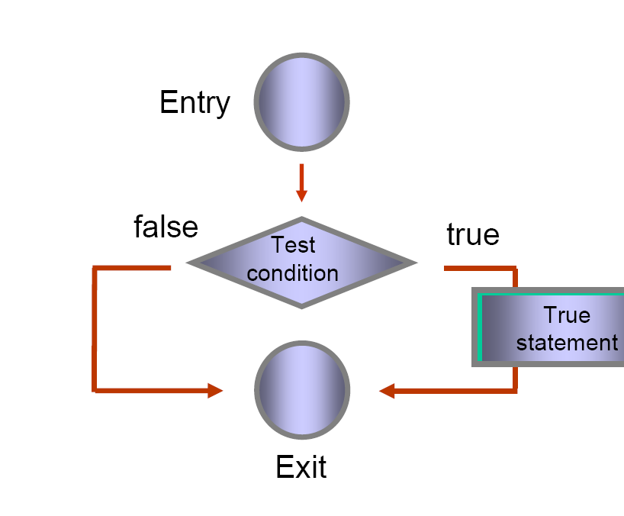
Problem Solving with Decisions

Slide 53
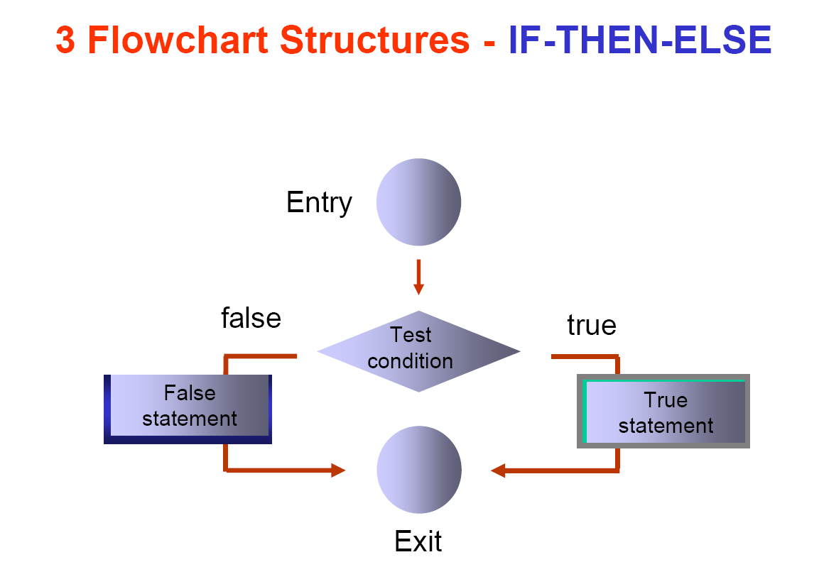

Slide 54
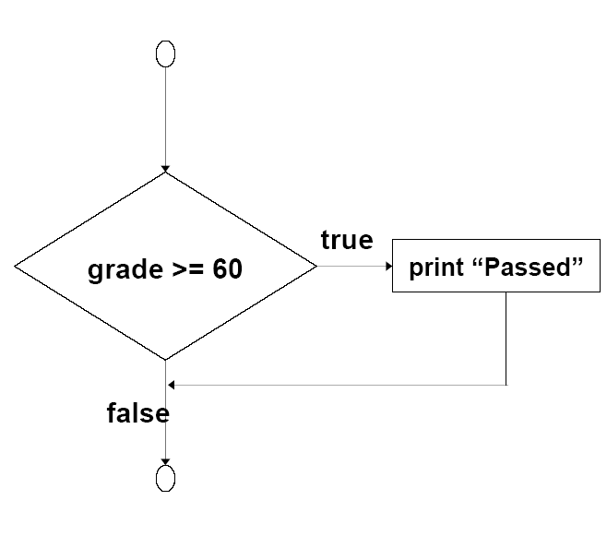

Slide 55
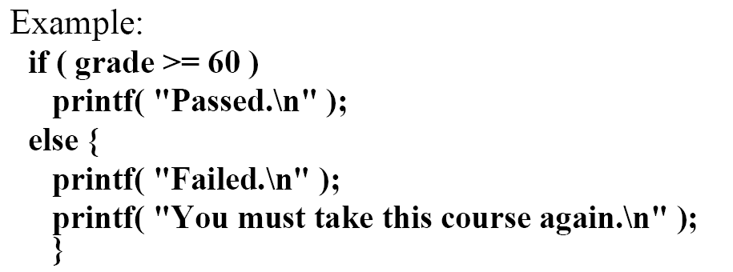

Slide 56
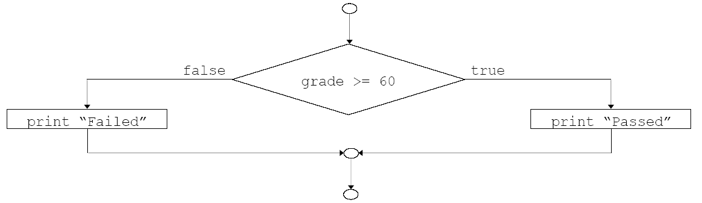

Slide 57
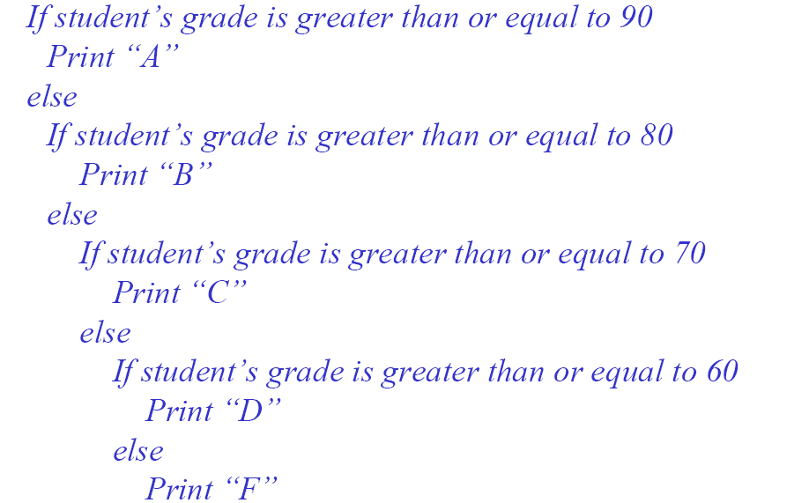
ALGORITHMS FOR Nested If Else

Slide 58
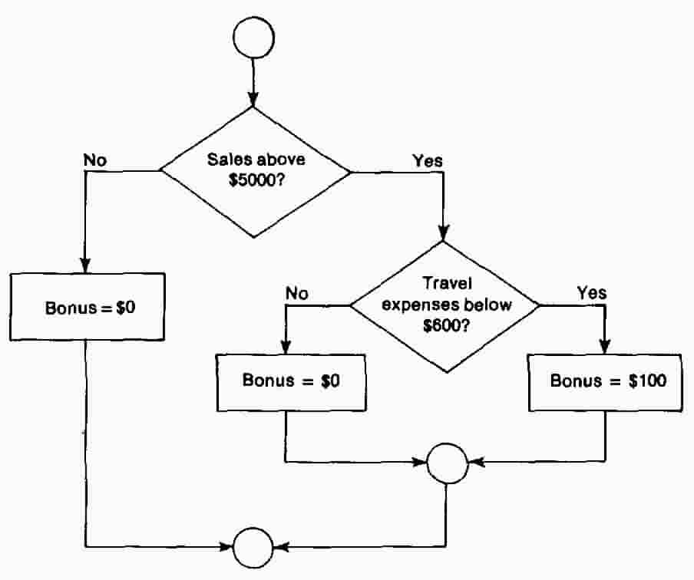

Slide 59
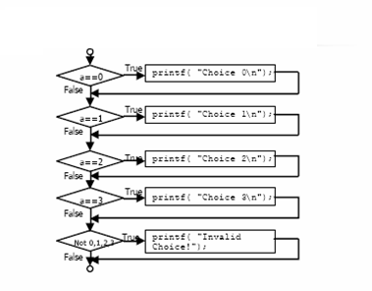
Straight-through logic:
It means that all of the decisions are processed sequentially one after the other.

Slide 60
Positive Logic Algorithm
IF record_code = “A” THEN
increment counter _A
ELSE
IF record_code = “B” THEN
increment counter _B
ELSE
IF record_code= “C” THEN
increment counter_C
ELSE
Display error message
ENDIF
ENDIF
ENDIF
Notes:
This linear nested IF structure can be replaced with a case control structure.

Slide 61
Positive Logic Flowchart
Increment_Record
TRUE
FALSE
Record_code = ‘A’
Record_code = ‘B’
T
A = A + 1
FALSE
B = B + 1
Record_code = ‘C’
T
FALSE
Error
C = C + 1
END

Slide 62
Negative Logic Algorithm
IF (record_code <> “A”) THEN
IF record_code <> “B” THEN
IF record_code <> “C” THEN
Display error
ELSE
increment counter_C
ENDIF
ELSE
increment counter _B
ENDIF
ELSE
increment counter _A
ENDIF
Notes:
This linear nested IF structure can be replaced with a case control structure.

Slide 63
Negative Logic Flowchart
Increment_Record
TRUE
FALSE
Record_code <> ‘A’
A = A + 1
FALSE
Record_code <> ‘B’
B = B + 1
T
FALSE
Record_code <> ‘C’
T
C = C + 1
Error
END

Slide 64
Logic Conversion
To convert from positive logic to negative logic
1.Change all < to >=.
2.Change all <= to >.
3.Change all > to <=.
4.Change all >= to <.
5.Change all = to <>.
6.Change all <> to =.
7.Interchange all of the Then set of instructions with the
corresponding Else set of instructions

Slide 65
Conversion from Positive logic to Negative Logic
Conditions :
Age Charge
Age<16 7
Age>=16 and Age <65 10
Age >=65 5

Slide 66
Positive to Negative
A
A
F
If Age<16
T
F
If Age>=16
T
Charge=7
T
If Age <65
T
Charge=7
F
If Age>=16
F
Charge=5
Charge=10
Charge=10
Charge=5
B
B

Slide 67
Algorithm
If Age<16
Then
Charge=7
Else
If Age<65
Then
Charge=10
Else
Charge=5
If Age>=16
Then
If Age>=65
Then
Charge=5
Else
Charge=10
Else
Charge=7
T
T
T
F
F
T
F
F

Slide 68
Decision Table
A Decision Table consists of four parts
1.The Conditions
2.The Actions
3.The combination of True and False for the Conditions
4.The action to be taken or the consequences for each
combination of conditions

Slide 69
DECISION TABLE FORMAAT
Condition1 | T | T | T | T | F | F | F | F
Condition2 | T | T | F | F | T | T | F | F
Condition3 | T | F | T | F | T | F | T | F
All Possible combinations of T and F
List of Coniditions
Action1 |  | x |  |  |  | x |  | x
Action2 | x |  |  | x | x
Action3 |  |  | x |  |  |  | x
Consequences
List of Actions

Slide 70
Four steps to develop a Flowchart
Draw all the decisions in flowchart form.
Compare the true and false sides of each decision, starting with the first one.
Eliminate any decisions that have the same instructions on both the true and false sides, keeping the true consequences or action.
Redraw the Flowchart.

Slide 71
Pseudocode
Pseudocode for each of the major steps like "make a list of black's legal moves", like so:
for each black piece
  for piece type in a given location
  make a list of next possible locations

Slide 72
An algorithm
An algorithm typically picks up one of these steps and details out various data structures in a symbolic language
- get_legal_moves(board, color):
- for i,j in board_dimensions
- if piece_at i,j is of color
- if piece type is KNIGHT
add the following to the next moves list:
location i+1 j+2, i-1 j+2... etc
- if piece type is rook
add locations:....
You can see that the algorithm has to be very precise to be useful.

